Slide 1
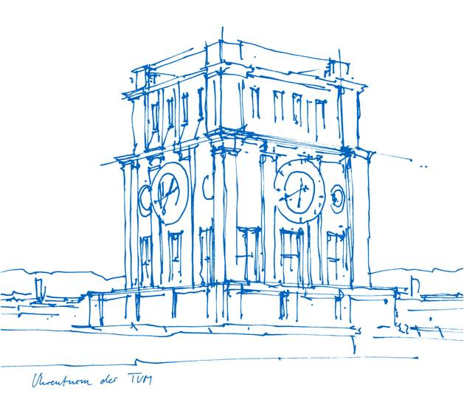
Introduction to ROS_Group8
Autonomous Driving
Penglin Li
Yijia Qian
Zibo Xie
Ziou Hu
Joshua
Technische Universität München
07.2024
Notes:
Good morning, I am Joshua from group 8 and my teammates and I have worked together on the Autonomous Driving project.

Slide 2
Task Distribution
Module | Contributors
Perception | Yijia Qian
Planning | Ziou Hu
State machine | Penglin Li
Controller_node | Zibo Xie
Documentation | Joshua
Notes:
The tasks are distributed as shown in the table,

Slide 3
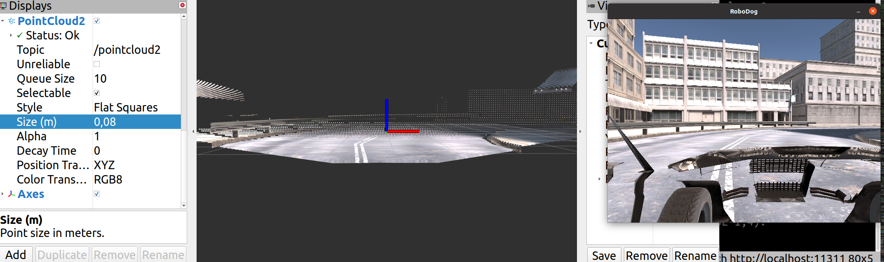
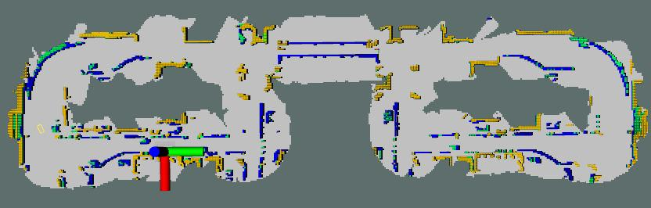
Perception pipeline
pointcloud2
octomap_server
unity_ros
depth image
generatePointCloud_node
pointcloud
move_base_new
pointcloud2
octomap
Notes:
In perception piple, point cloud is generated using the depth image provided by Unity Simulator, And the point cloud2 is the input of the octomap server to create the octomap, while the pointcloud is the input of the move base for path planning and trajectory planning.

Slide 4
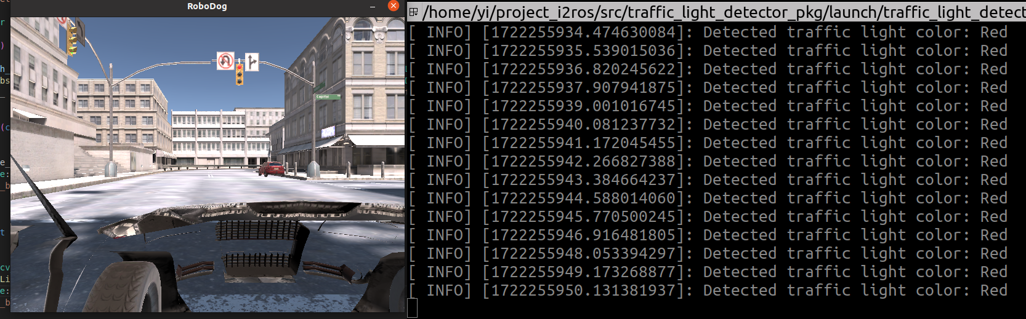
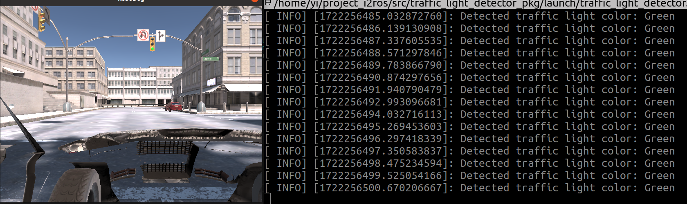
Perception: traffic lights detection
Solution: traditional CV-based detection
Red light:
Green light:
RGB image
recognition result
Notes:
We extract the position of the trafflic light from semantic image and achieve color detection with the help of RGB image. The recognition result will be published to a topic "traffic_light_state" and the state of machine will subscribe this topic.

Slide 5
Planning: move_base
/realsense/depth/pointcloud
input of move_base:
sensor transforms
odom source
sensor source
goal
local
costmap
global
costmap
/tf
out of move_base:
/odom
local planner
global
planner
the desired linear speed
the desired angular speed
/cmd_vel
/goal
Notes:
The move base package is applied for planning. Here is a structure of move base.

Slide 6
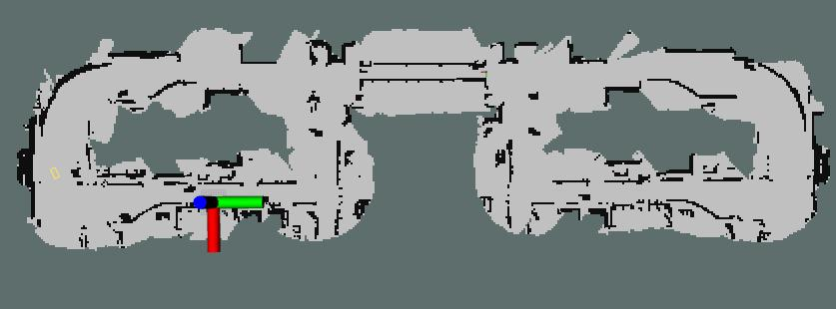
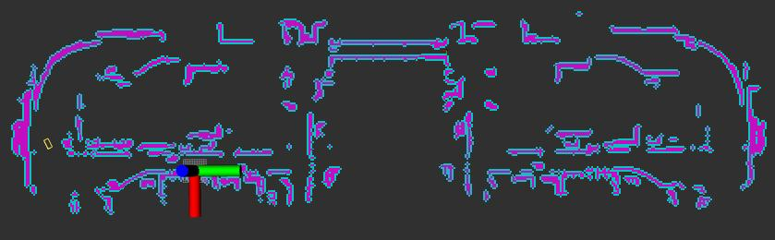
Mapping
Octomap_server was used to model the 3D arbitrary environment and to generate the 2D occupancy grid
The occupancy grid was then used to create the costmap
more detailed
assigns costs to different areas based on obstacles and free space
Map_expander was used to expand the size of OccupancyGrid by filling the whole map with -1 in a non-detected area
For move_base to plan the path to a point even outside of the map.
Waypoint_publisher was used to publish a series of Poses that the vehicle should follow.
Serves as navigation goals to guide the vehicle’s movement
Consumed by path planning and control nodes
Occupancy Grid
Costmap
Notes:
For mapping, the octomap package was first used to generate the occupancy grid, before using the occupancy grid to generate a costmap. The costmap allows for a more detailed representation of the map, where different areas are assigned different costs based on obstacles and free space. The Map_expander node was used to expand the size of OccupancyGrid by filling the whole map with -1 in a non-detected area, for the move_base node to plan the path to a point even outside of the map. The Waypoint_publisher node was used to publish a series of Poses that the vehicle should follow, and Serves as navigation goals to guide the vehicle’s movement. It is Consumed by the path planning and control nodes

Slide 7
Planning: Waypoint Global Planning
Dijkstra algorithm
Single shortest path
Non-negative edge weights
Notes:
The Dijkstra algorithm was used for waypoint global planning, as it sources the single shortest path for a graph with non-negative edge weights.

Slide 8
Planning: Local planning
TrajectoryPlannerROS
generate velocity commands
avoids obstacles
aheres to vehicle kinematic constraints
Notes:
the TrajectoryPlannerROS node was used for local planning, as it is able to generate velocity commands, avoid obstacles, and adhere to the kinematic constraints of the vehicle.

Slide 9
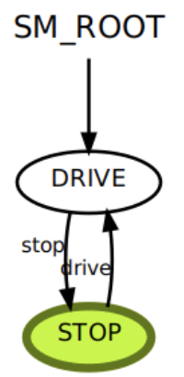
State Machine
Function 1: control the vehicle to stop
Notes:
Regarding the state machine module, the primary function is to control the vehicle to stop by entering the Stop State when the Traffic Light Detector detects a red light.

Slide 10
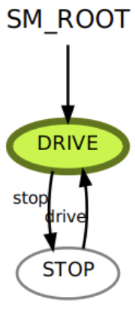
State Machine
Function 1: control the vehicle to drive
Notes:
When the light turns green, the state machine switches to the Drive State and transmits the predicted velocity from trajectory planning to the vehicle control module.

Slide 11
State Machine
Function 2: handle unexpected situations
E.G. The vehicle unexpectedly missed the detection range of the traffic light when it is stopping.
Solution: Maintain the Drive State when the Traffic Light Detector does not detect a signal or detects an unknown signal.
Notes:
The second function is to handle unexpected situations. For example, if the traffic light turns red just as the vehicle is about to leave the intersection, the state machine will stop the vehicle. Due to inertia, the vehicle may accidentally roll out of the detection range of the Traffic Light Detector. However, the state machine will still enable the vehicle to proceed and safely pass through the intersection. The solution is: Maintain the Drive State when the Traffic Light Detector does not detect a signal or detects an unknown signal.

Slide 12
Controller_node
Controls the acceleration, deceleration, and turning, enables the car to reach the target linear and angular velocities.
The controller_node recevies two topics, current-state and target-state.
/move_base
/cmd_vel
/state_machine
target_angular_velocity
target_linear_velocity
/unity_ros
/current-state-est
/controller_node
/car_commands
Notes:
Controller_node controls the acceleration, deceleration, and turning, enables the car to reach the target linear and angular velocities. It recevies two topics, current-state and target-state.

Slide 13
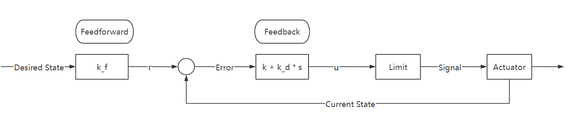
Controller_node
Feedforward-control: It is used to compensate for steady-state error.
Feedback-control: PD control is used to obtain the control signal.
Limitation: The signal is constrained to ensure it remains within a proper range.
Notes:
The dynamic model is unknown, so all the parameters are gotten by testing. It can only reach 90% of the desired state without feedforward control. (PPT内容也要读)

Slide 14
Limitation
Unable to complete full route
complex turns towards the end of the route
interaction between local plan and controller not fully optimised
several bugs in the turns
interval where the traffic light remains green is too short
very small window to move off the line
Notes:
We only able to complete half of the route as the turns towards the end were too complex and the interaction between the local plan and the controller was not fully optimised. there were also several bugs in the turns, and the interval of the traffic light remaining green was too short which gave us a very small window to move the car off the line.

Slide 15
Feedback
The project work was challenging but fruitful
Setting weekly discussions and milestones as a group improved communication and teamwork
Project may be too complex for beginners
Notes:
Some feedback that we had was that the project was challenging but fruitful, and we had fun doing it. Setting weekly discussions and milestones as a group also helped us to improve communication and teamwork. However, we felt that the project may be too complex for beginners.

